Slide 1
Convolutional Neural Networks
Computer Vision
Alexandru Buburuzan

Slide 2
Data
CNN
Content
Training
Computer Vision
Convolution

Slide 3

What is Computer Vision?
A field of Artificial Intelligence (AI) that enables computers to understand images and video.
https://towardsdatascience.com/everything-you-ever-wanted-to-know-about-computer-vision-heres-a-look-why-it-s-so-awesome-e8a58dfb641e

Slide 4
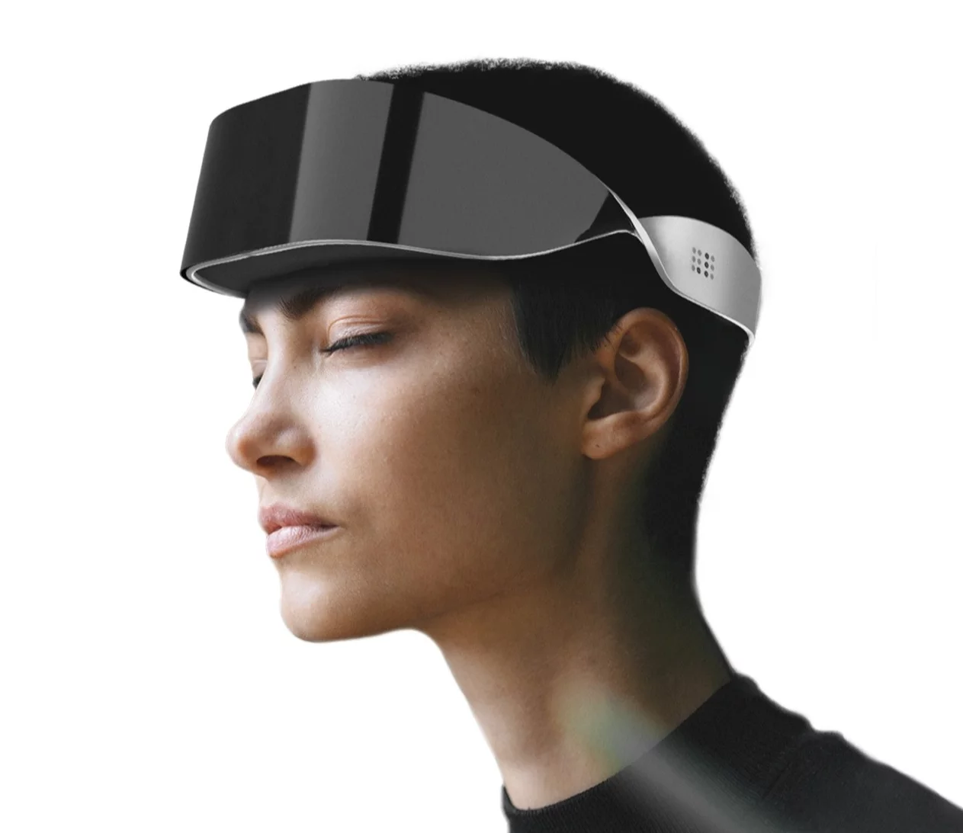
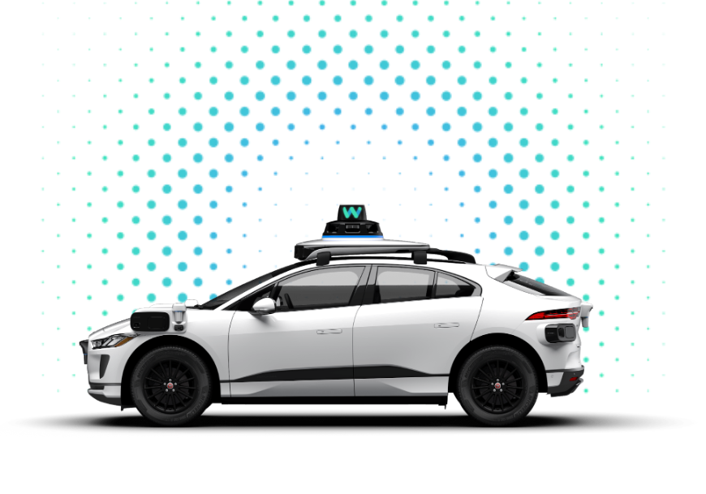
Computer Vision applications
https://www.dotlumen.com/
https://waymo.com/
“.lumen builds glasses that help the blind live a better life”
Waymo self-driving car
Notes:
A mission of mine is to get you all excited about the field so that’s why I included quite a few use cases of Computer Vision

Slide 5
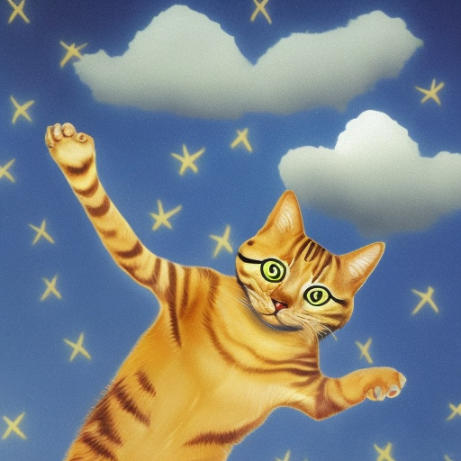
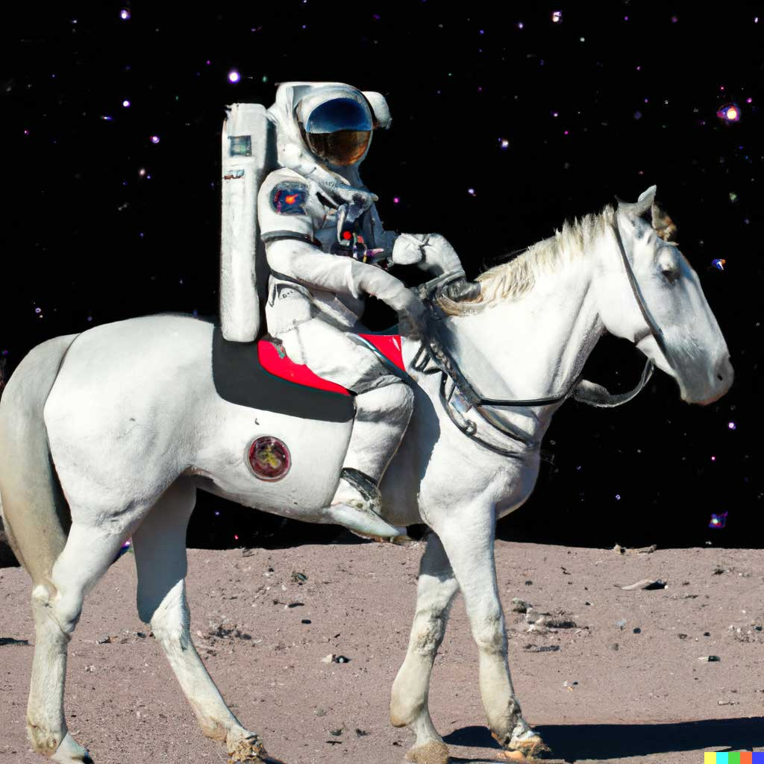
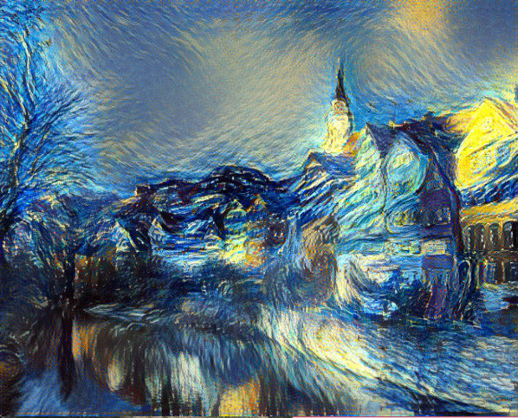
Computer Vision Applications
Generated using stable diffusion
https://openai.com/dall-e-2/
https://www.researchgate.net/figure/Neural-Style-Transfer-example-of-Tuebingens-Nackarfront-in-the-style-of-Vincent-van-Goghs_fig2_330383053

Slide 6
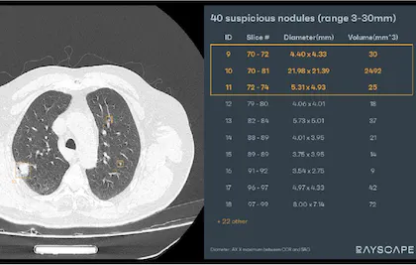
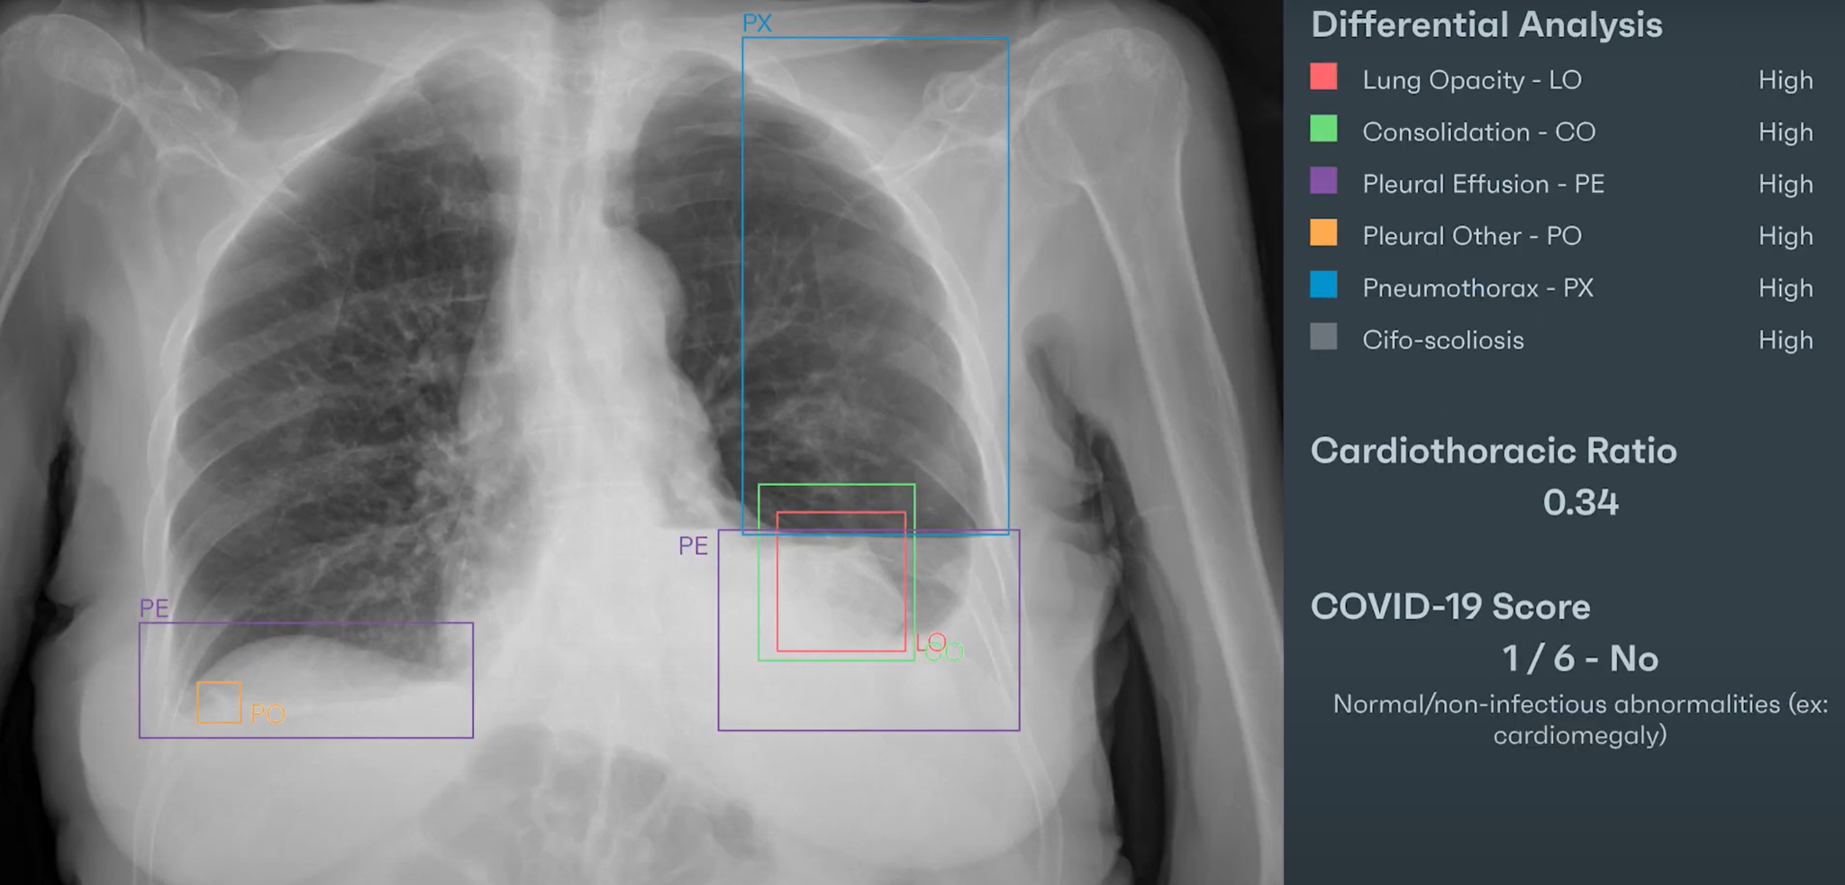

Medical Image Analysis
Detect pathologies on chest X-Rays
Detect and measure lung nodules on CT scans

Slide 7
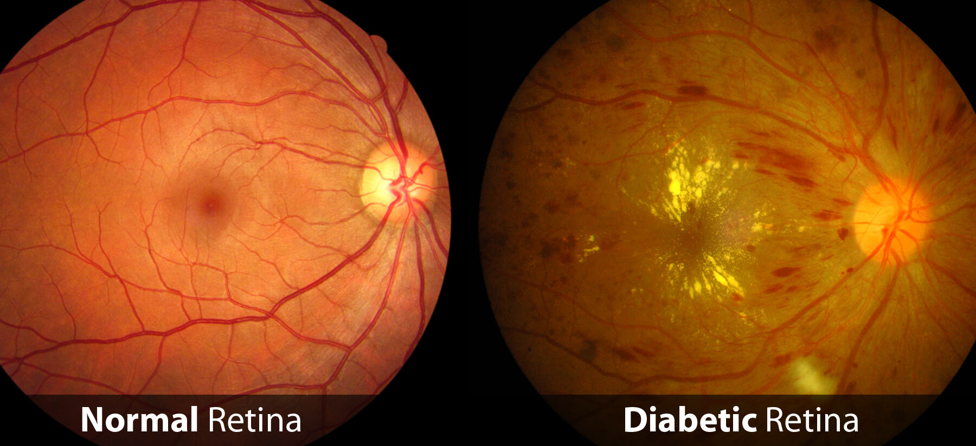
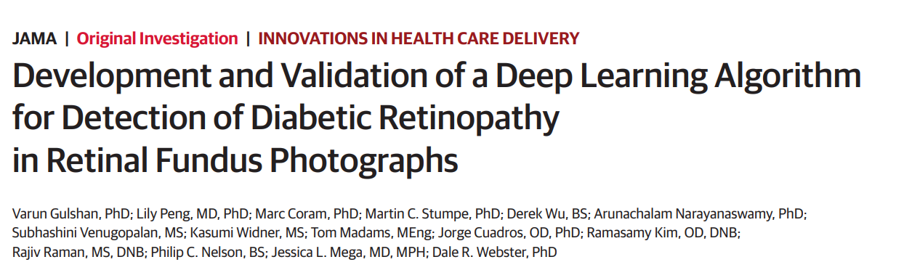
Computer Vision for Diabetic Retinopathy
https://www.raleighop.com/retina/diabetic-eye-disease/

Slide 8
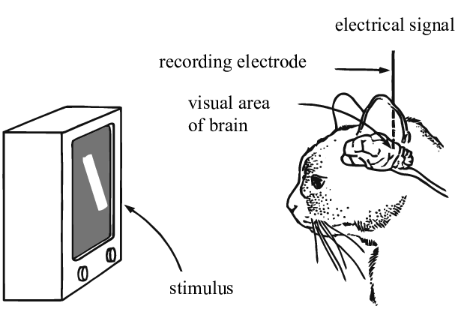
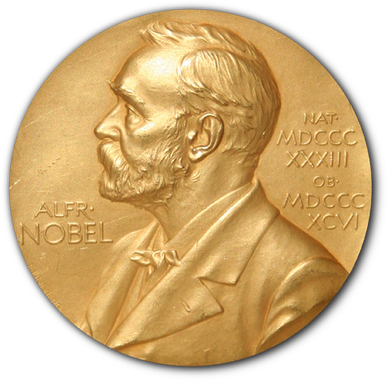
“Ridiculously” short history
Hubel & Wiesel 1959
Detect what stimuli makes neurons from a cat’s visual cortex fire
“Their breakthrough discoveries about the visual system and visual processing earned them the Nobel Prize for Physiology or Medicine in 1981”
https://braintour.harvard.edu/archives/portfolio-items/hubel-and-wiesel https://www.researchgate.net/figure/Fig-In-the-classic-neuroscience-experiment-Hubel-and-Wiesel-discovered-a-cats-visual_fig1_335707980 https://en.wikipedia.org/wiki/Nobel_Prize
Notes:
Viszal

Slide 9
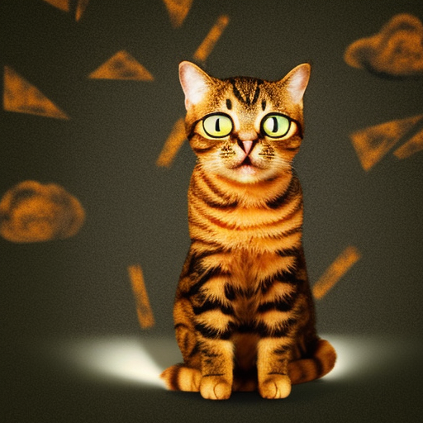
Image Multiclass classification setup
DOG
CAT
CAR
…
HORSE
Input
Black Box
aka “The Model”
Output
Generated using stable diffusion

Slide 10
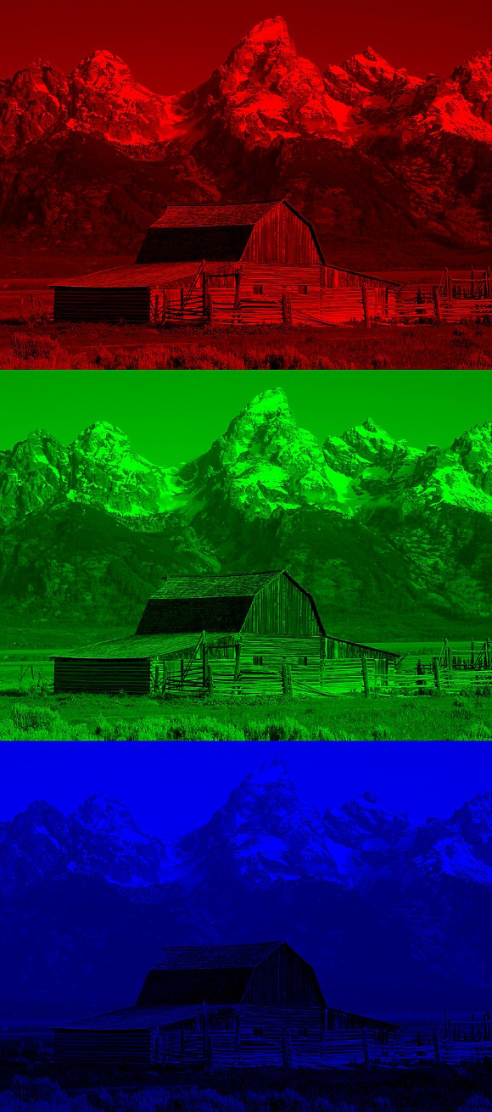
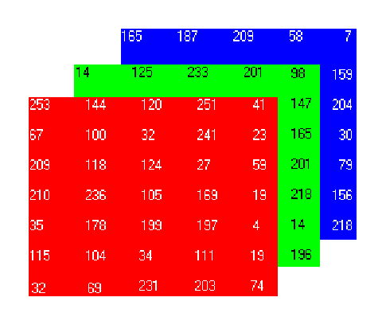
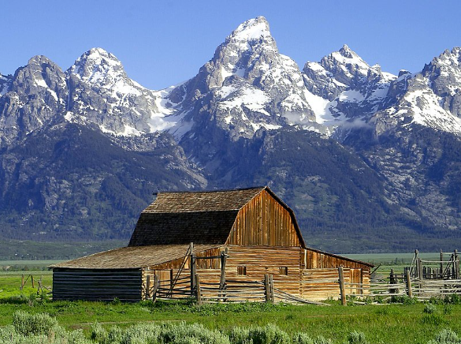
The data: images
RGB Image
Matrix representation with values in the range 0-255 representing color intensity
Red, Green, Blue channels
https://www.topcoder.com/thrive/articles/how-does-the-machine-read-images-and-use-them-in-computer-vision
https://en.wikipedia.org/wiki/RGB_color_model
Notes:
A colored image is composed of multiple colors and all colors can be generated from three (red, green and blue) colors.

Slide 11
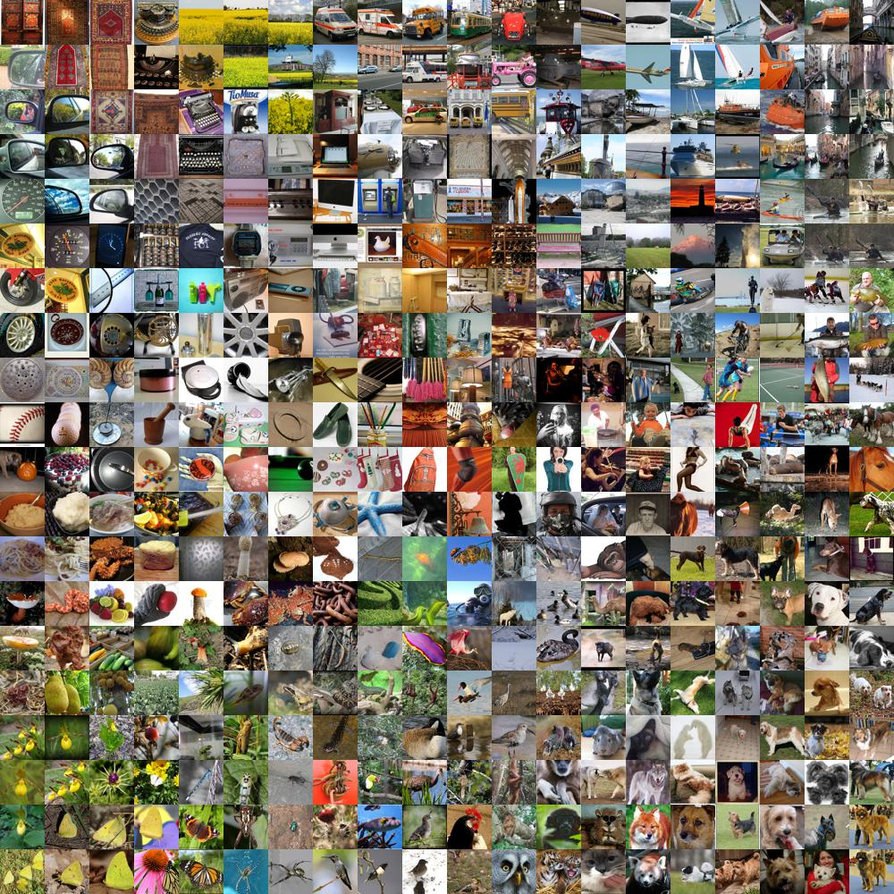
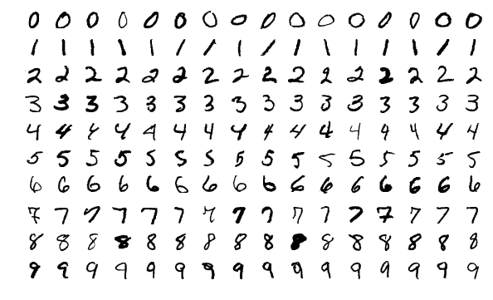
Well-known datasets
https://cs.stanford.edu/people/karpathy/cnnembed/
https://en.wikipedia.org/wiki/MNIST_database http://yann.lecun.com/exdb/mnist/
The ImageNet dataset is comprised of 14,197,122 images spanning 1000 classes
The MNIST database has 70000 examples of handwritten digits

Slide 12
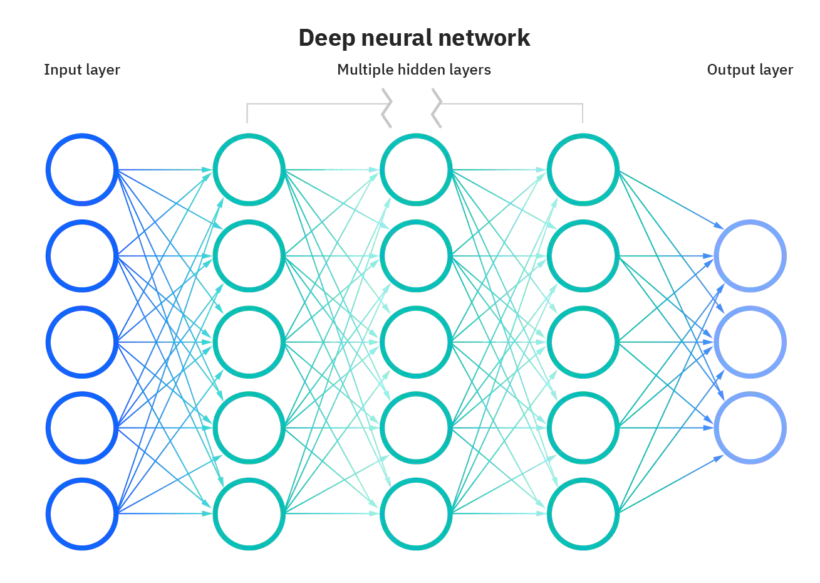
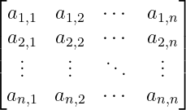
First approach: simple ANN
Flatten
Probabilities for each class
3×N×N Matrix
3N² values
https://www.ibm.com/cloud/learn/neural-networks

Slide 13
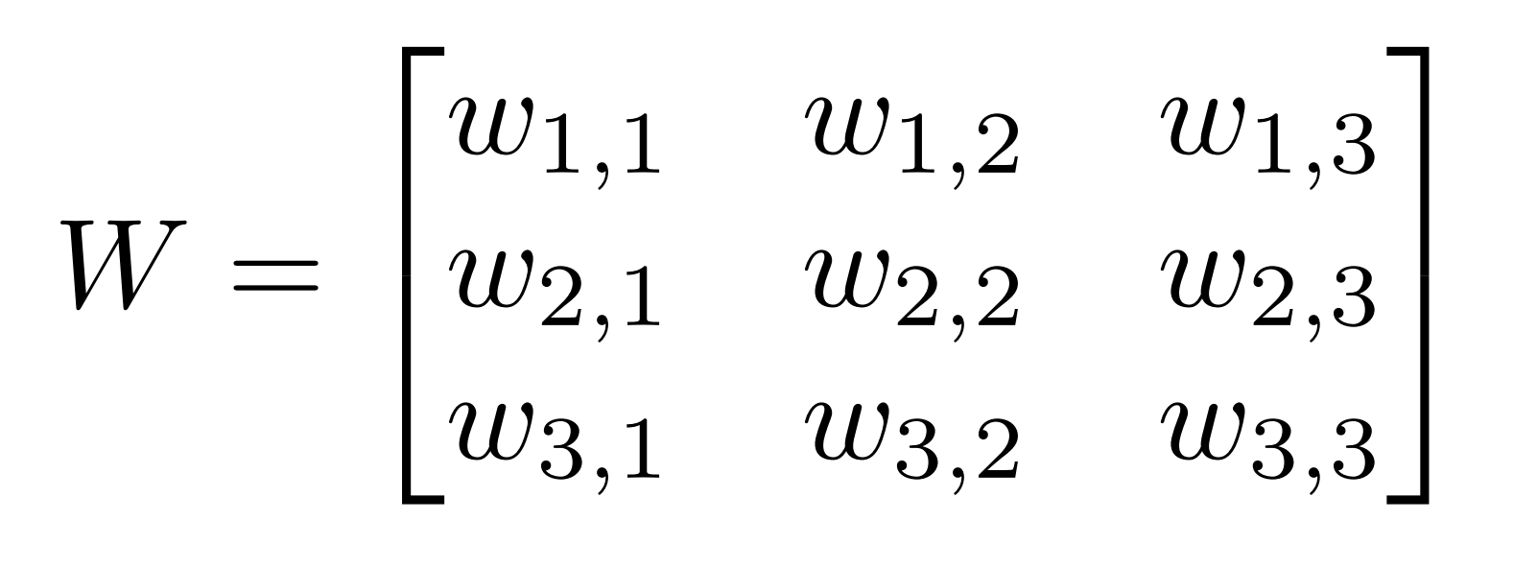
The issues
The size of the input vector
eg: for a 512x512 RGB image the input vector has 786,432 dimensions
A simple ANN used to model this task would have too many parameters
We need some sort of parameter sharing
Small changes in the image will drastically change the flattened input vector
It is hard for the simple ANN to extract features
Obs: individual pixels depend on their neighborhood (inductive bias)
w_{i,j}
Σ
Activation
Kernel
Notes:
If only there was “something” to do this, the world would probably be a better place!
Introduce kernel here

Slide 14
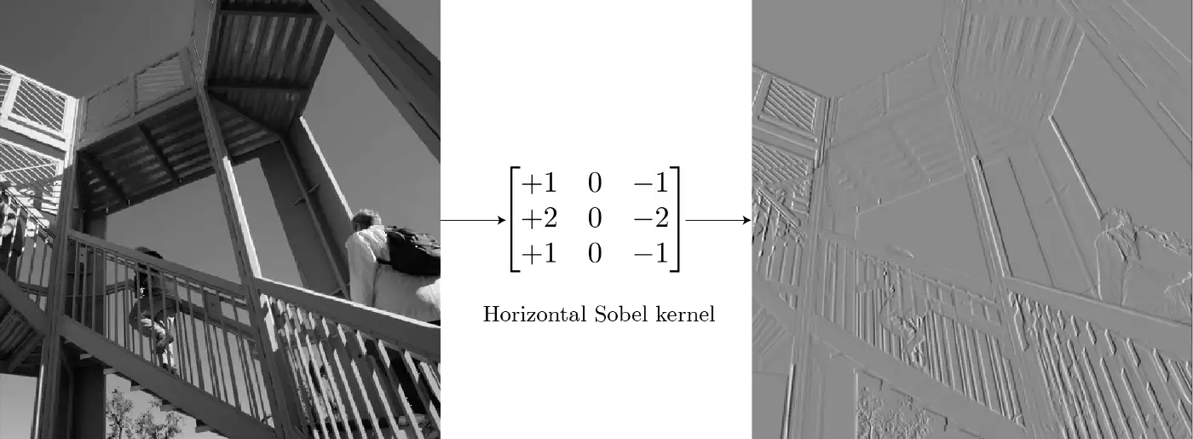
It’s all about feature extraction
Sobel kernel emphasises edges

Slide 15
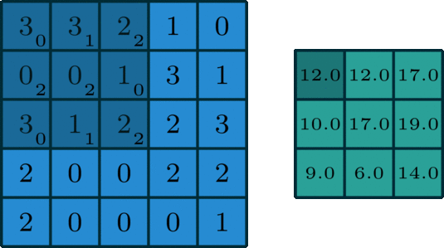
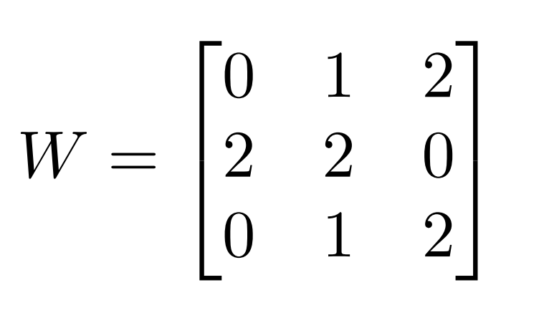
Convolution
Slide the kernel (small metrix) over the image and multiply values accordingly
Q: What about RGB images? A: The kernel is a small “cube”
Q: What if I want to extract multiple features? A: use a multiple kernels
×
0
×
1
×
2
×
2
×
2
×
0
1
2
×
0
×
×
Output
Input
Kernel
Linear Combination
3×0 + 3×1 + 2×2 + 0×2 + 0×2 + 1×0 + 3×0 + 1×1 + 2×2 = 12
Notes:
Idea of channels
Linear combination
More specific about the kernel
Start with static

Slide 16


Convolution
Padding
Defines how the border of a feature map is being handled
Stride
Defines the step size of the kernel when traversing the image.
https://towardsdatascience.com/types-of-convolutions-in-deep-learning-717013397f4d
Notes:
Padding
Talk about how you can preserve size

Slide 17
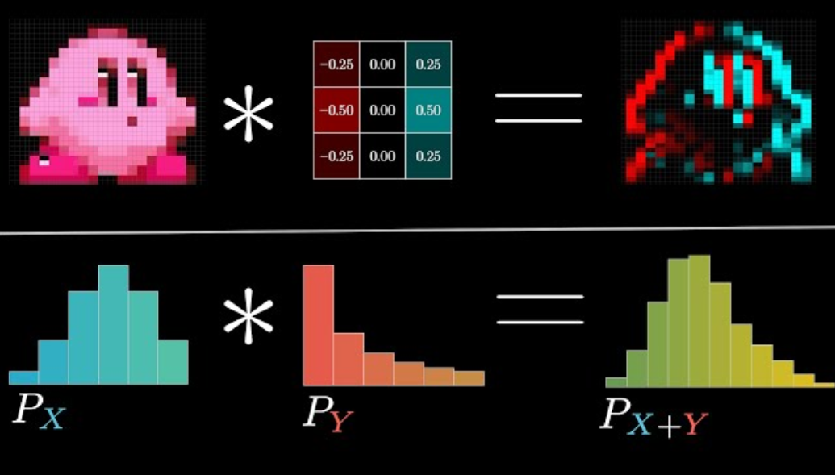
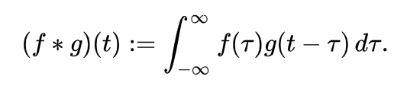
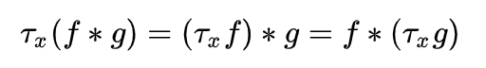
Convolution: extra
But what is a convolution?
3blue1brown
The convolution of f and g
Translational equivariance
bit.ly/3b1b-Conv
Notes:
add short link

Slide 18
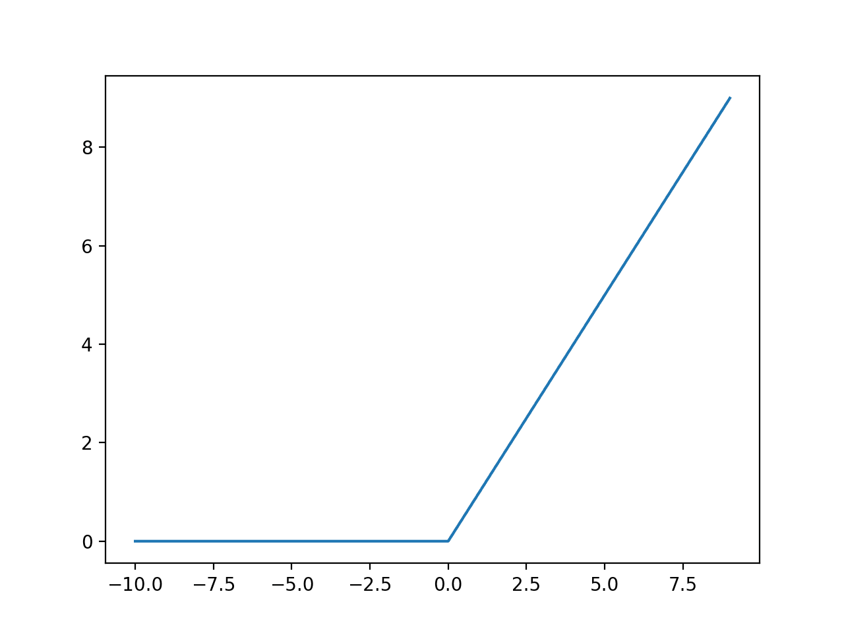

Other elements
Max Pooling
Rectified Linear Unit (ReLU)
https://paperswithcode.com/method/max-pooling
https://machinelearningmastery.com/rectified-linear-activation-function-for-deep-learning-neural-networks/
Notes:
MaxPool
A DL theorist might say that it is only used for reducing size
Introduces some invariance
ReLU:
adds non-linearity

Slide 19
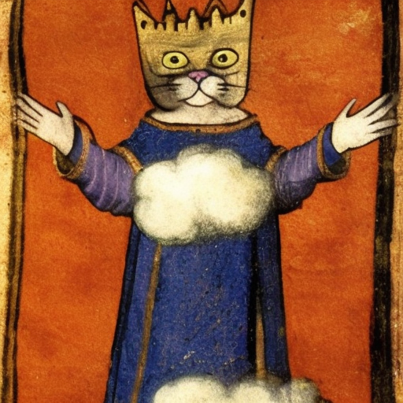
“The Model”, demystified
CNN
Notes:
I called it a Black Box so far … it’s time to demystify the model

Slide 20
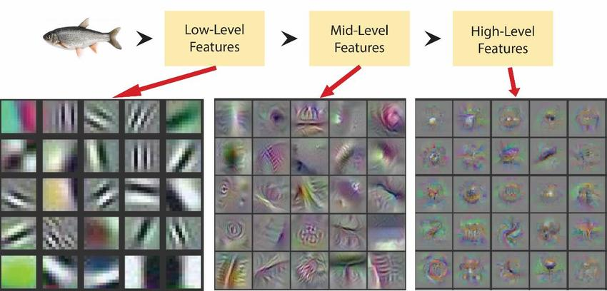
What do we need?
Siddiqui, S.A., Salman, A., Malik, M.I., Shafait, F., Mian, A., Shortis, M.R. and Harvey, E.S., 2018. Automatic fish species classification in underwater videos: exploiting pre-trained deep neural network models to compensate for limited labelled data. ICES Journal of Marine Science, 75(1), pp.374-389.
Notes:
Comparison with the Hubel and Weisel experiment

Slide 21

Convolutional Neural Network (CNN)
Image Embedding
https://towardsdatascience.com/a-comprehensive-guide-to-convolutional-neural-networks-the-eli5-way-3bd2b1164a53
Notes:
Talk about latent
Avoid explaining the structure (just say that it exchanges spatial info to semantical info)
Numbers are empirically determined

Slide 22
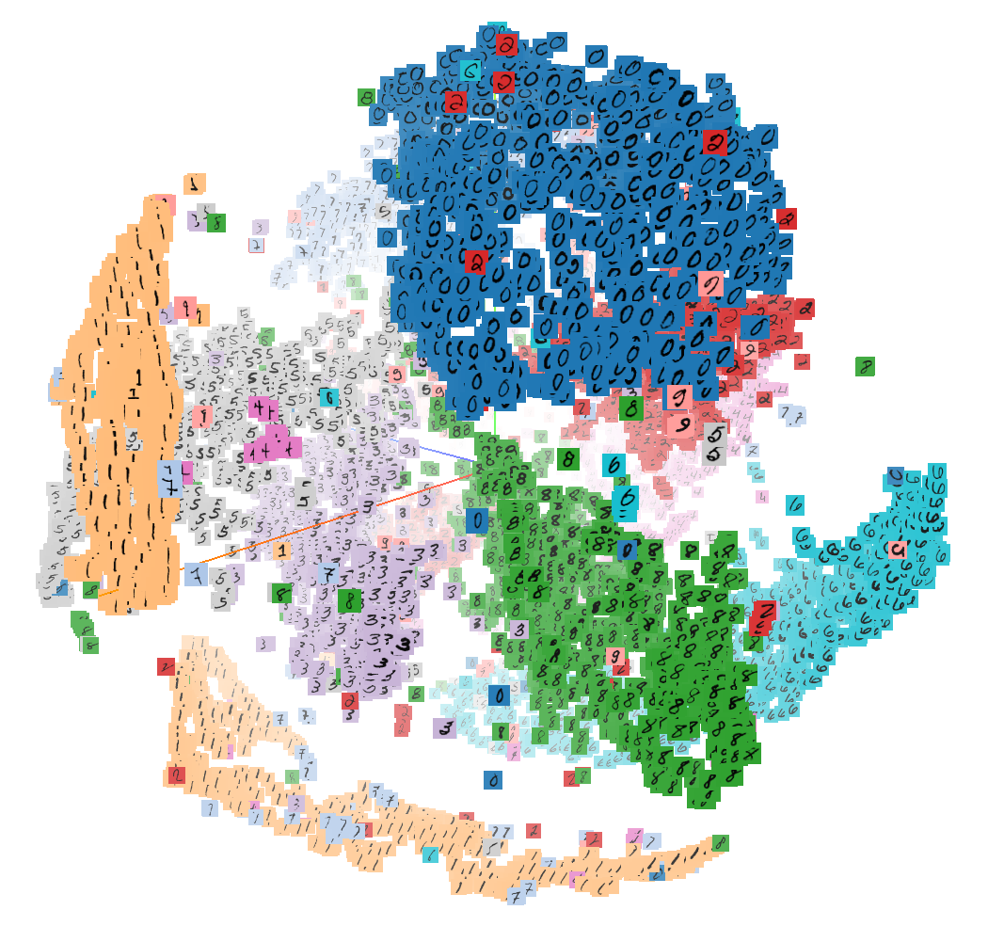
CNN: image embeddings
Image embeddings are semantically-strong low-dimensional representation
Embeddings of similar images should form clusters
Notes:
better explain image

Slide 23
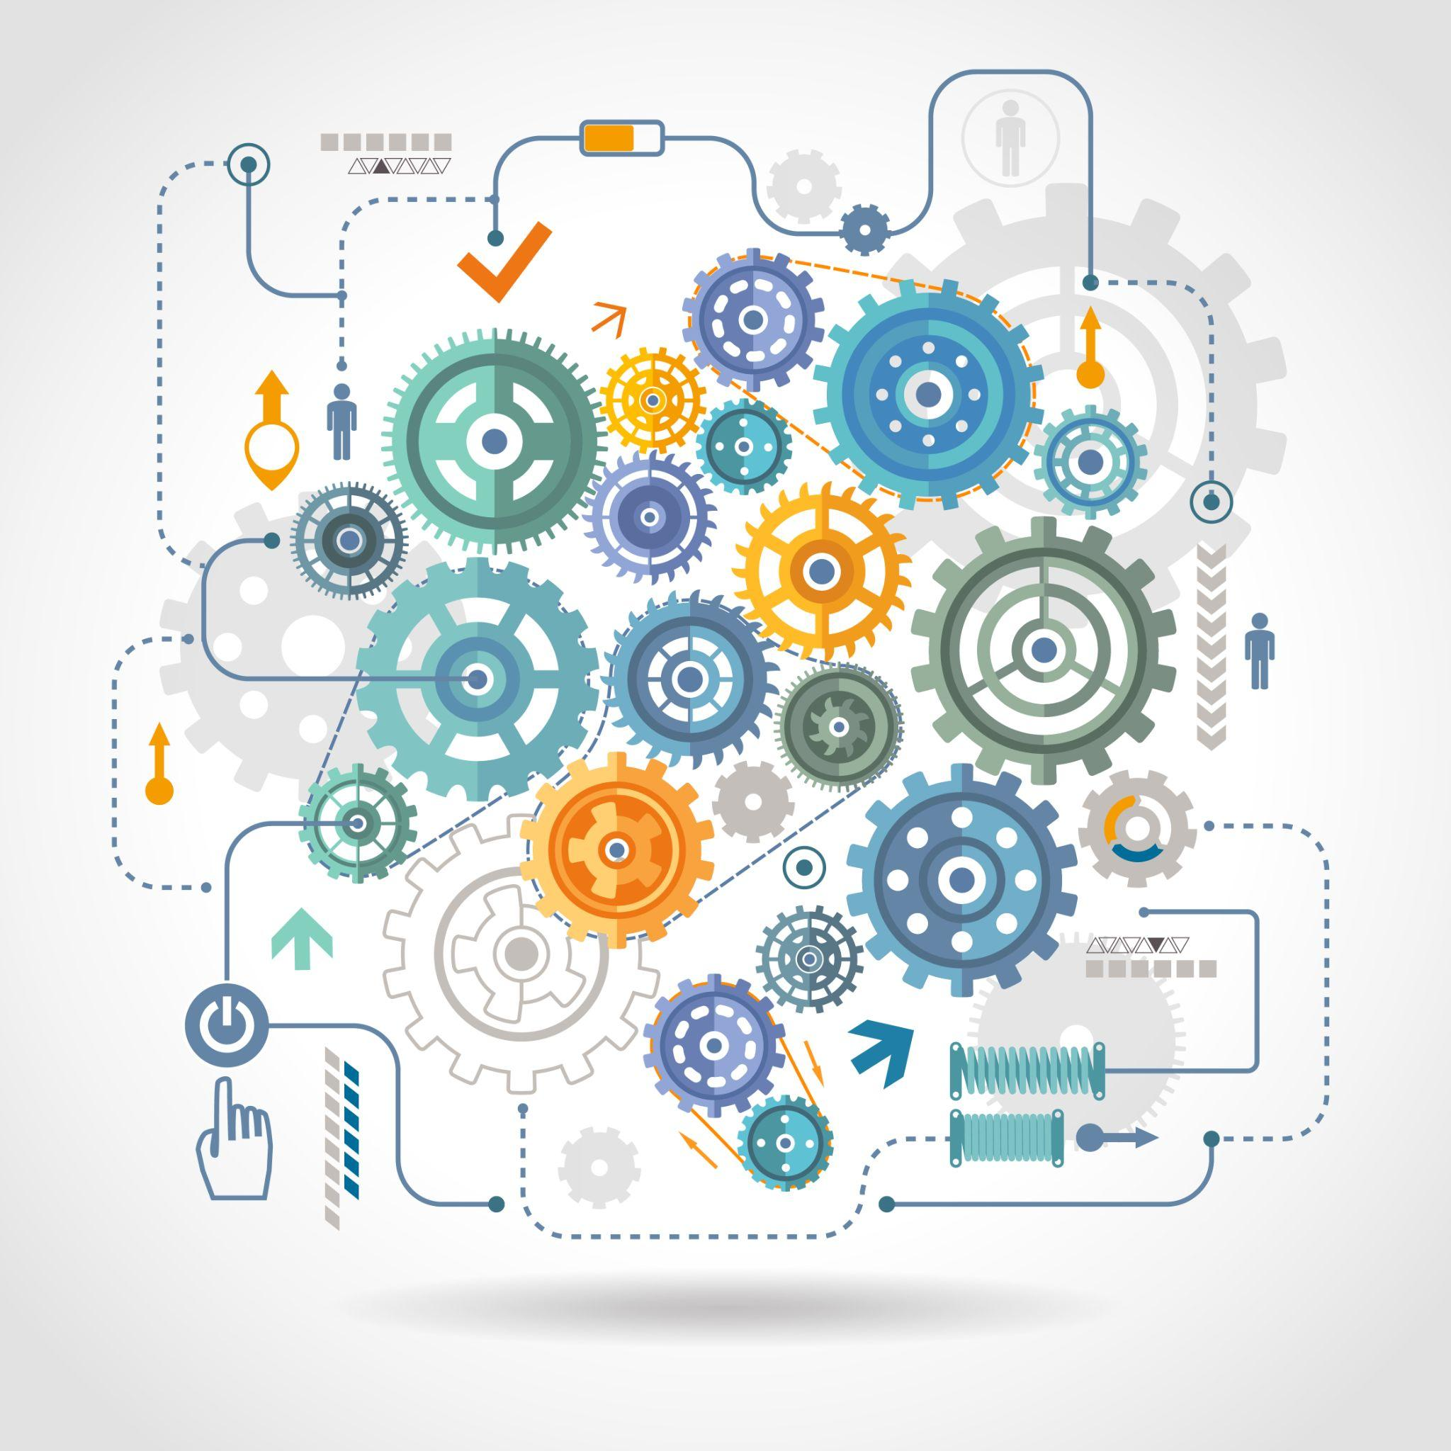
Training the model
Designed by macrovector_official / Freepik

Slide 24
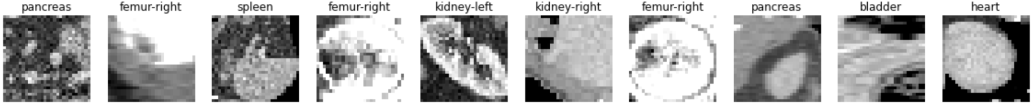
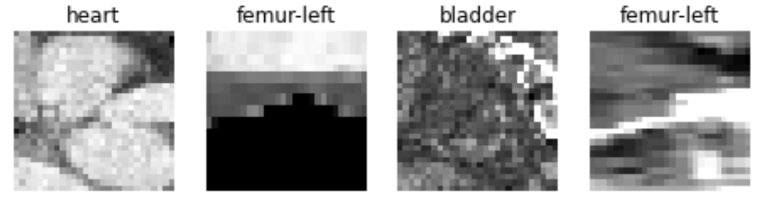
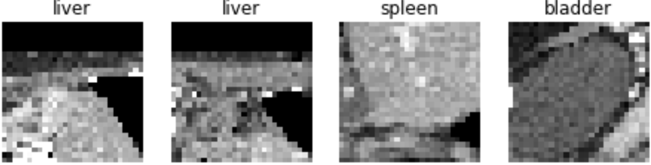
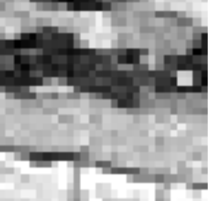
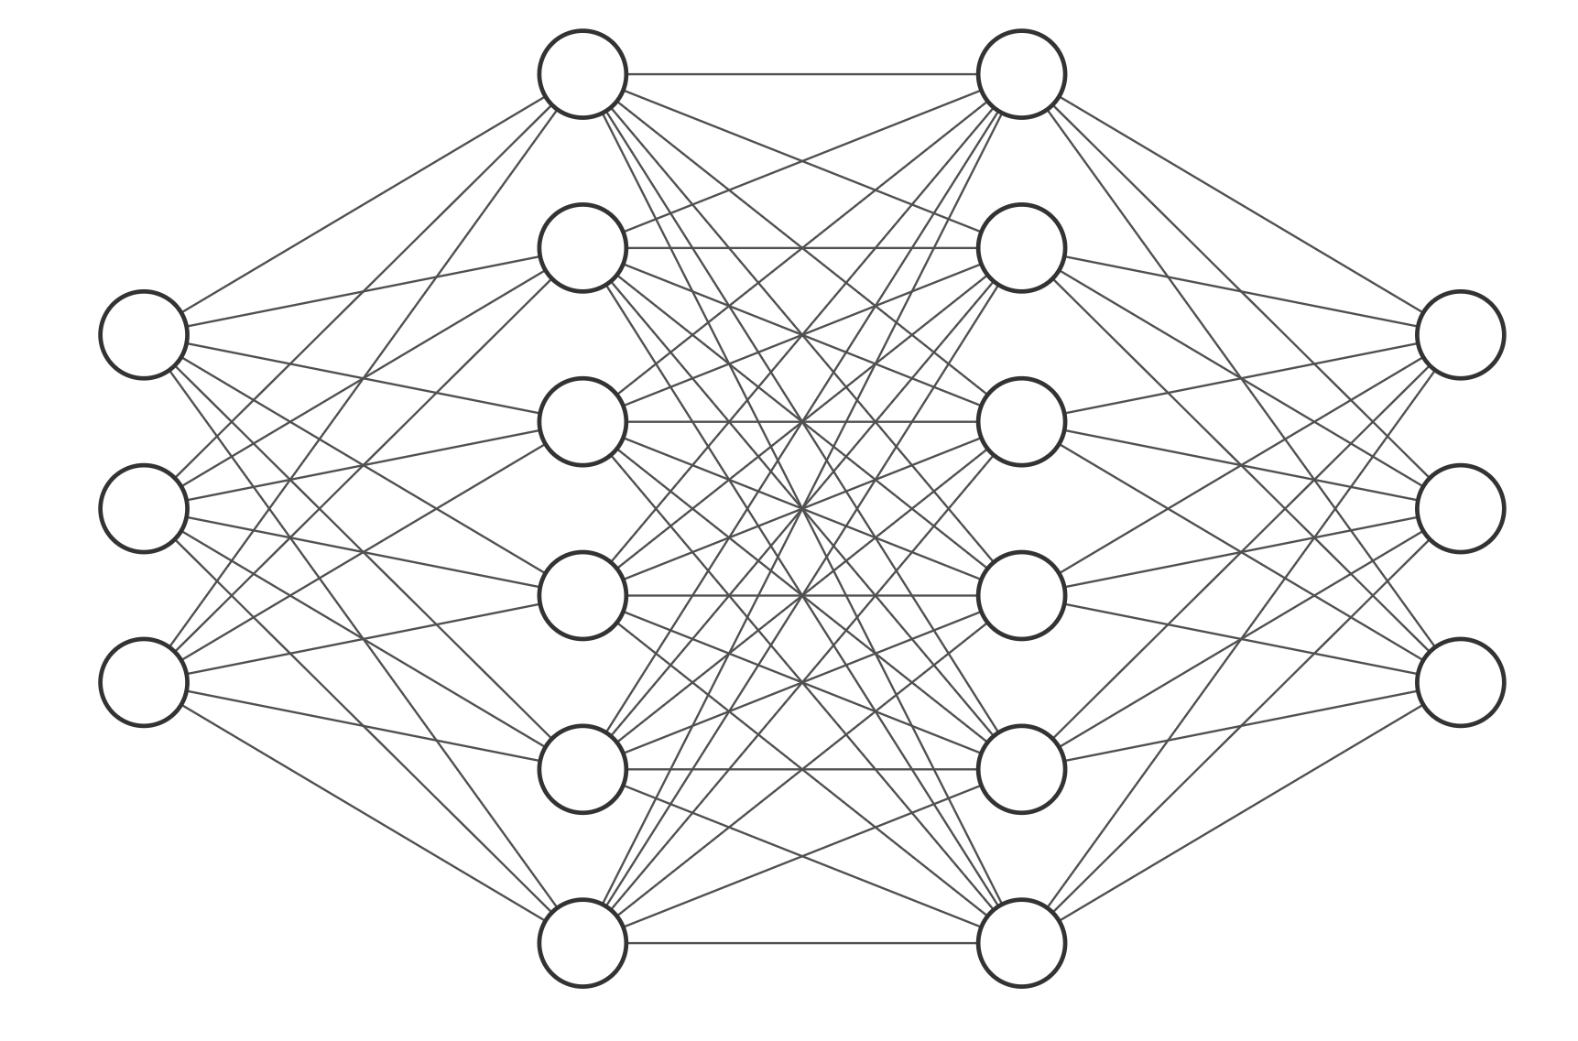
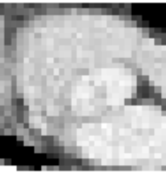
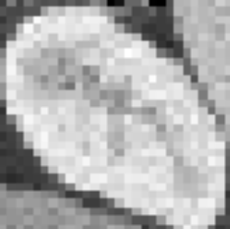
Setup
Train dataset
Validation dataset
Every epoch you ask: How good is my model?
SampleBatch
Backprop and update parameters
0.6
0.3
0.1
Loss
Liver
Heart
Spleen
Compare
Neural Network
Probs
Target

Slide 25
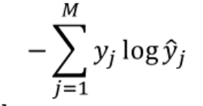

Loss and activation functions
Negative Log-Likelihood
Target
CAT
DOG
CAR
BEE
HORSE
Loss = -log(0.02) = 3.91

Slide 26
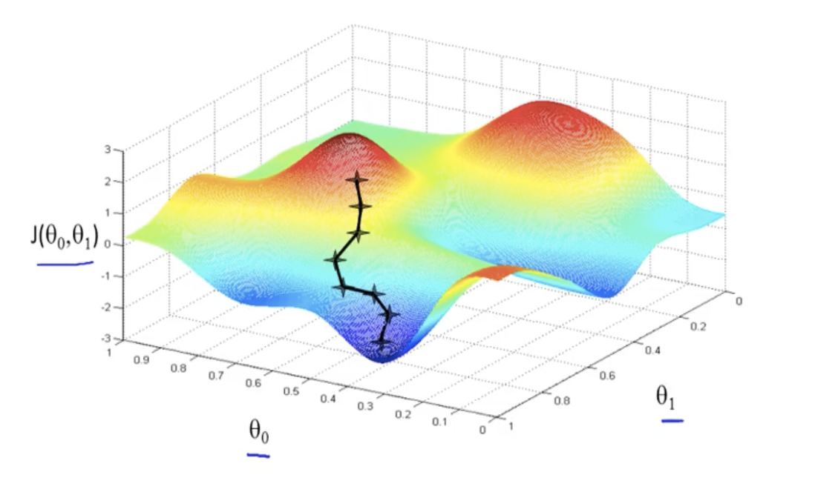
Stochastic Gradient Descent (SGD)
Batches are used because it is not possible to pass all images through the network at once.
The gradients computed for each batch are a good estimate of the true gradients
Source: Andrew Ng’s lecture on GD

Slide 27
bit.ly/CNN-MUDS

Slide 28
Additional References
http://cs231n.stanford.edu/slides/
https://en.wikipedia.org/wiki/Convolution
https://towardsdatascience.com/intuitively-understanding-convolutions-for-deep-learning-1f6f42faee1

